Slide 1
Faster R-CNN: Towards Real-Time Object
Detection with Region Proposal Networks
Hongzhi Liu
2018-07-30

Slide 2
CONTENTS
一. Algorithm learning
二. Code implementation
三. Experimental results
四. Further research
信息科学与工程学院
1/12

Slide 3
一、Algorithm learning
1. Faster R-CNN
State-of-the-art object detection networks depend on region proposal algorithms to hypothesize object locations.
Advances like SPPnet and Fast R-CNN have reduced the running time of these detection networks, exposing region proposal computation as a bottleneck.
信息科学与工程学院
2/12

Slide 4
一、Algorithm learning
2. RPN
In the paper, Shaoqing Ren and Kaiming He introduce a Region Proposal Network (RPN) that shares full-image convolutional features with the detection network, thus enabling nearly cost-free region proposals.
A Region Proposal Network (RPN) takes an image as input and outputs a set of rectangular object proposals, each with an objectness score.
信息科学与工程学院
3/12

Slide 5
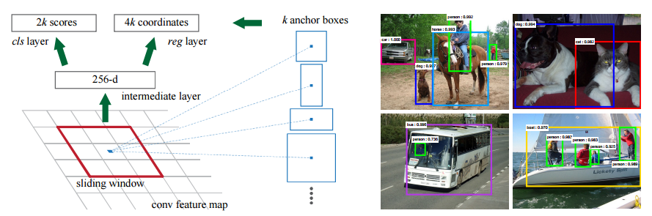
一、Algorithm learning
2. RPN
In the paper, Shaoqing Ren and Kaiming He introduce a Region Proposal Network (RPN) that shares full-image convolutional features with the detection network, thus enabling nearly cost-free region proposals.
信息科学与工程学院
4/12

Slide 6
一、Algorithm learning
3. Anchors
To generate region proposals, authors slide a small network over the convolutional feature map output by the last shared convolutional layer.
At each sliding-window location, they simultaneously predict multiple region proposals for each location is denoted as k. The k proposals are parameterized relative to k reference boxes, which can be called anchors. For anchors, there are 3 scales with box areas of 128²,256², and 512² pixels, and 3 aspect ratios of 1:1, 1:2, and 2:1.
信息科学与工程学院
5/12

Slide 7
二、Code implementation
1. Train a VOC model
In order to prepare URPC2018, I need to evaluate the performance index of the Faster R-CNN algorithm.
Firstly, I spend four days to build environment and run a demo. Then I setup VOC2007 datasets and download pre-trained models and weights to train a model by using the server.
信息科学与工程学院
6/12

Slide 8
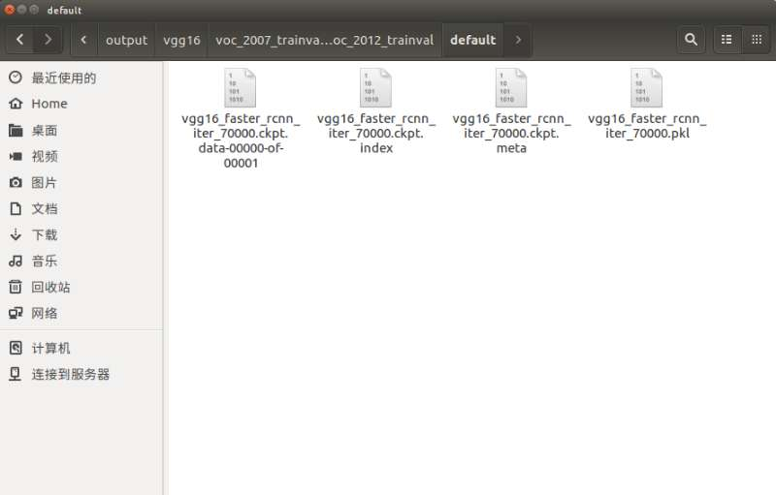
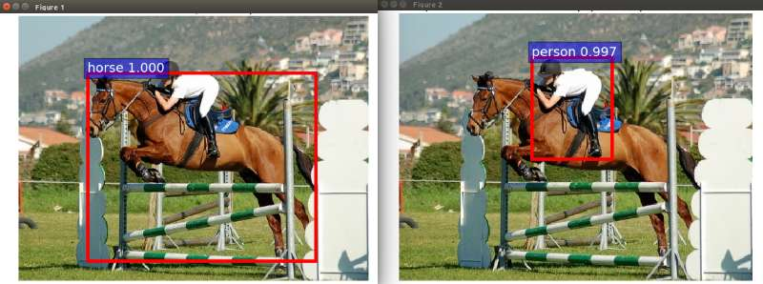
二、Code implementation
信息科学与工程学院
7/12

Slide 9
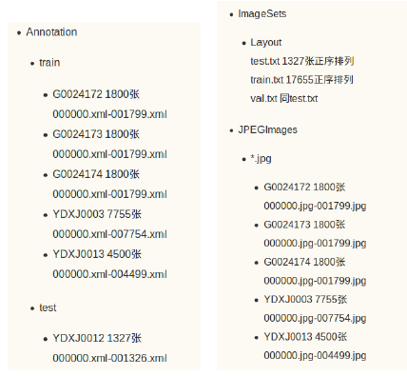
二、Code implementation
2. Train a contest model
Before training a contest model, there is something I need to do.
To begin with, our team try to change the txt truth table into xml files which are used for training contest model.
信息科学与工程学院
8/12

Slide 10
二、Code implementation
3. Code modification
Then I take efforts to modify demo.py codes and several config codes.
CLASSES=('__background__','"seaurchin"','"scallop"','"seacucumber“’)
net.create_architecture("TEST",4,tag='default', anchor_scales=[8, 16, 32])
信息科学与工程学院
9/12

Slide 11
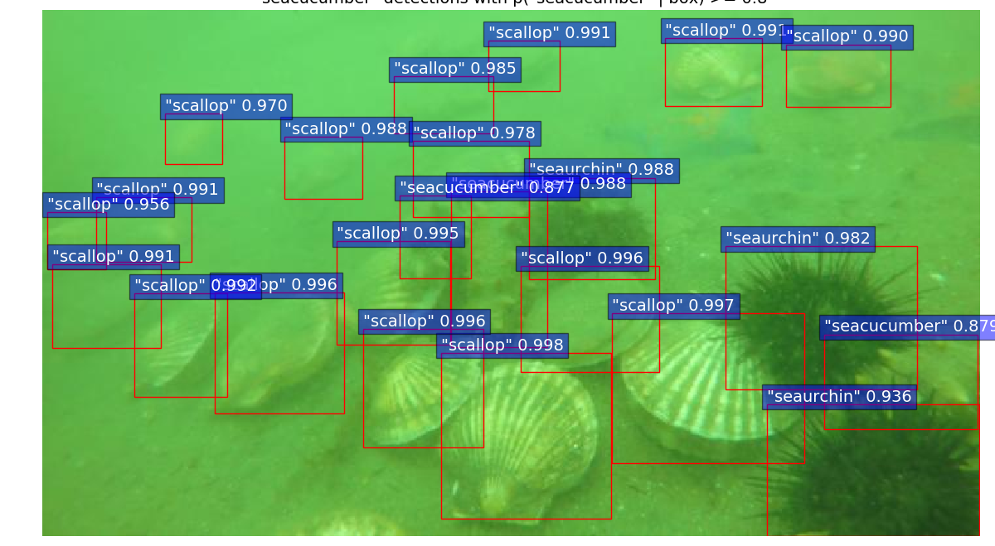
三、Experimental results
信息科学与工程学院
10/12

Slide 12
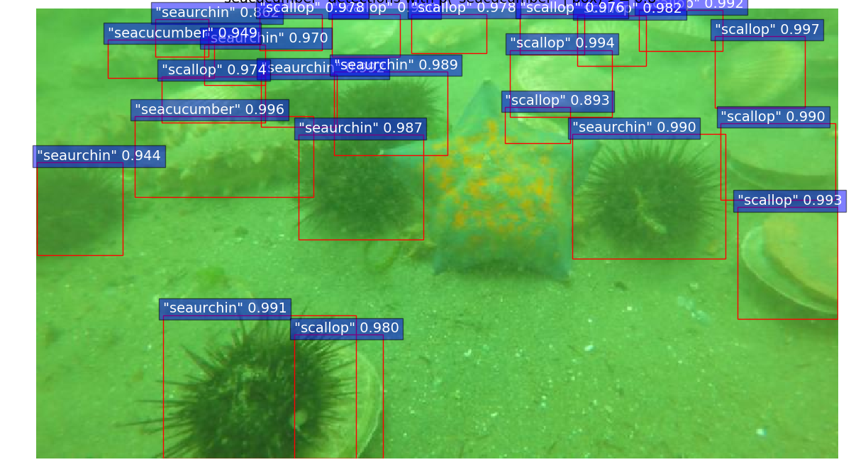
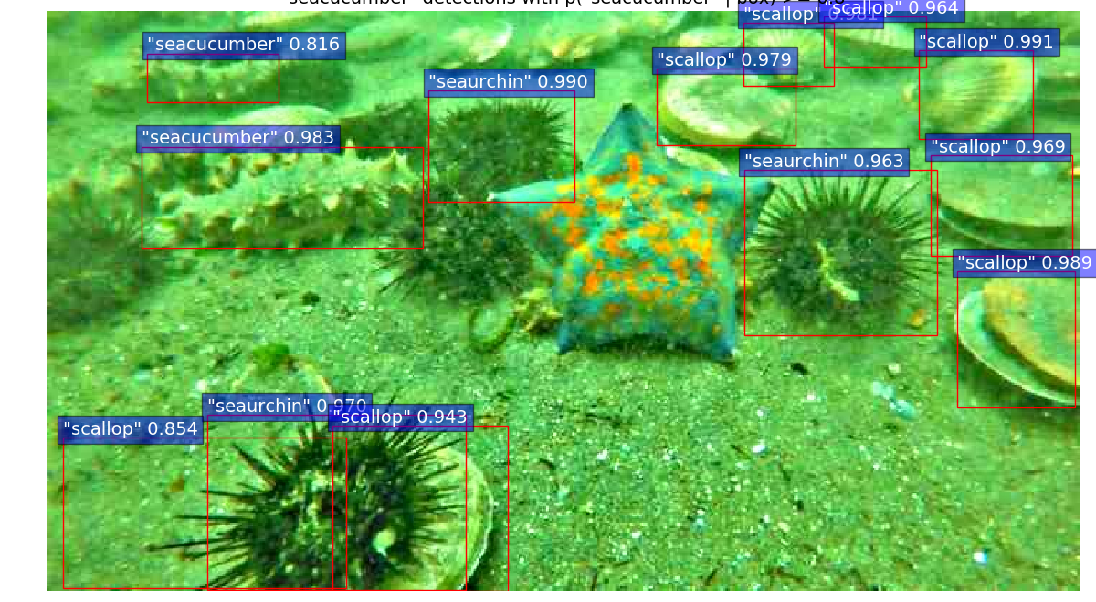
三、Experimental results
信息科学与工程学院
11/12

Slide 13
四、Further research
1. mAP calculation
2. Train a model with enhance picture datasets
3. Test with OpenCV
信息科学与工程学院
12/12

Slide 14


